Slide 1
Science
Education Center
Submitted to:
Madav sha
Sign ---------→
Submitted BY:
Prayash panta
Class:9(b)
Roll no:14

Slide 2
Contents of This Project
Here Are the list of things that are mention In this project:
Introduction to Human Brain
Describe cerebellum with Figure
Describe cerebrum with Figure
Describe spinal cord with Figure
Describe medulla oblagata with Figure

Slide 3
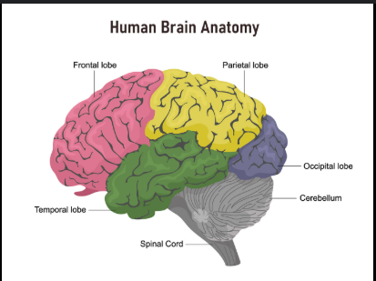
Human Brain
The brain is like the boss of your body. It helps you think, feel, remember things, move around, and understand what's happening around you. It also keeps your body working properly, like making sure you breathe and your heart beats. It make Your body work.
U also have brain with weight 2% of your body
Thinking and Reasoning
Remembering
Sleeping and Waking Up
Autonomic Control
Some Interesting Brain Facts
Your brain works faster than a supercomputer when processing images or making quick decisions.
It feels no pain

Slide 4
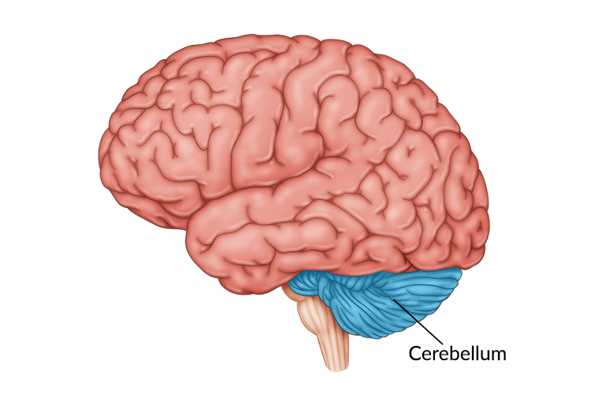
The cerebellum is also called the small brain. It is found at the back of your head below the big brain and behind the brainstem. It helps you move your body. It keeps your balance. It helps with walking and standing straight. It controls how your body moves.
People mostly know the cerebellum for body movement. But now scientists say it also helps with thinking feeling and talking.
If you drink beer it can affect your cerebellum. That is why people cannot walk straight or lose balance when they drink too much.
Balance
Coordinate
Posture
Maintain movement learning (learning Using movement of body like dance and playing instrument or title
Some Interesting Brain Facts
The cerebellum is only about 10% of your brain's size but it holds over 50% of your brain’s neurons . that's more brain cells than the rest of your brain combined!
The cerebellum is like a muscle memory coach it helps you get better at things like dancing riding a bike or playing piano without thinking about every move. The more you practice the smarter your cerebellum gets

Slide 5
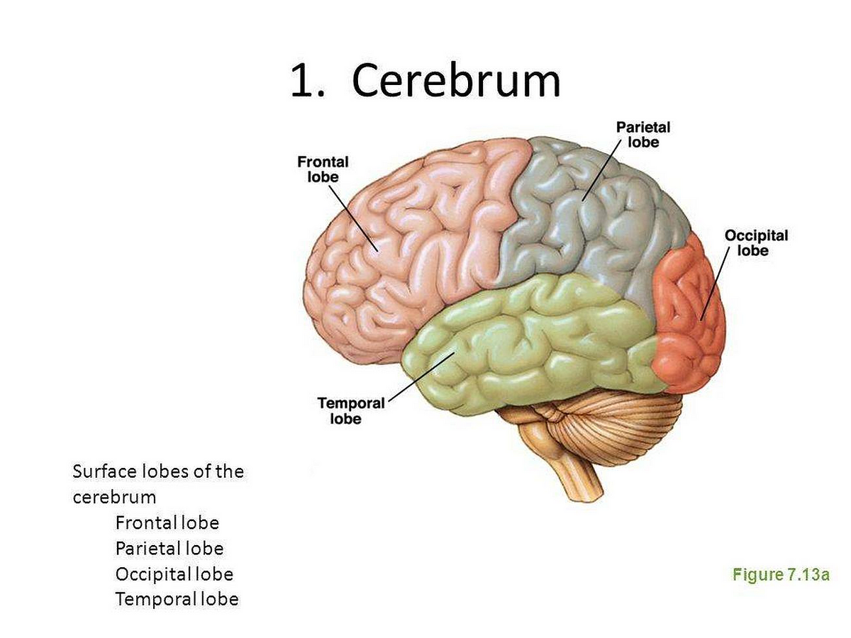
The cerebrum is the largest part of your brain. It is the top part that you usually picture when you think of a brain and divided into two halves left and right Hetepheres.
Thinking and Decision Making
It helps you think and make choices.
Memory
It helps you remember things like names places and events.
Emotions
It helps you feel happy sad angry and more.
Movement
It helps you move your body by sending signals to your muscles.
Interesting Facts about the Cerebrum
It is divided into two halves. The left side controls the right side of your body and the right side controls the left side of your body.
Two cerebrums are not exactly alike. Just like fingerprints every brain is different especially in how the folds and grooves are shaped.

Slide 6
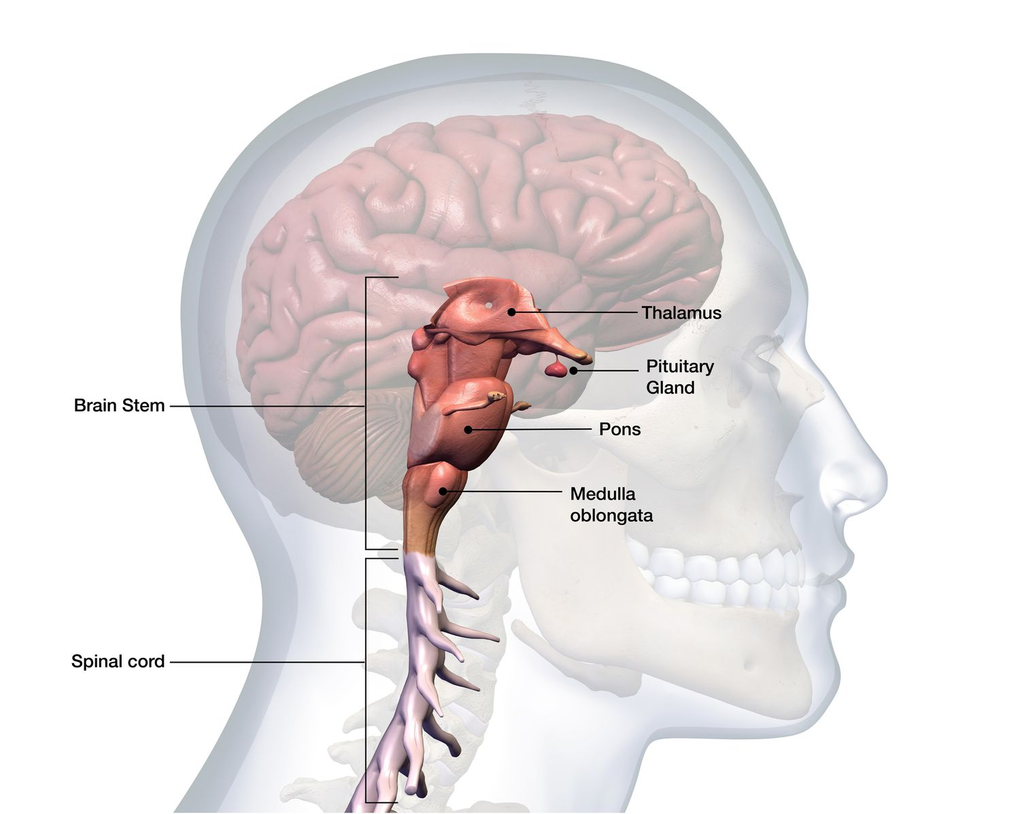
The medulla oblongata is a small but super important part of the brain located at the bottom of the brainstem, where the brain connects to the spinal cord. In case of Damage person dies
Breathing
Heartbeat
Blood Pressure
Digestion
You can’t live without it – Damage to the medulla oblongata is often fatal because it controls essential life functions like breathing and heart rate.
Works automatically – The medulla does all its jobs without you having to think — you don’t tell your heart to beat or your lungs to breathe, it just happens!

Slide 7
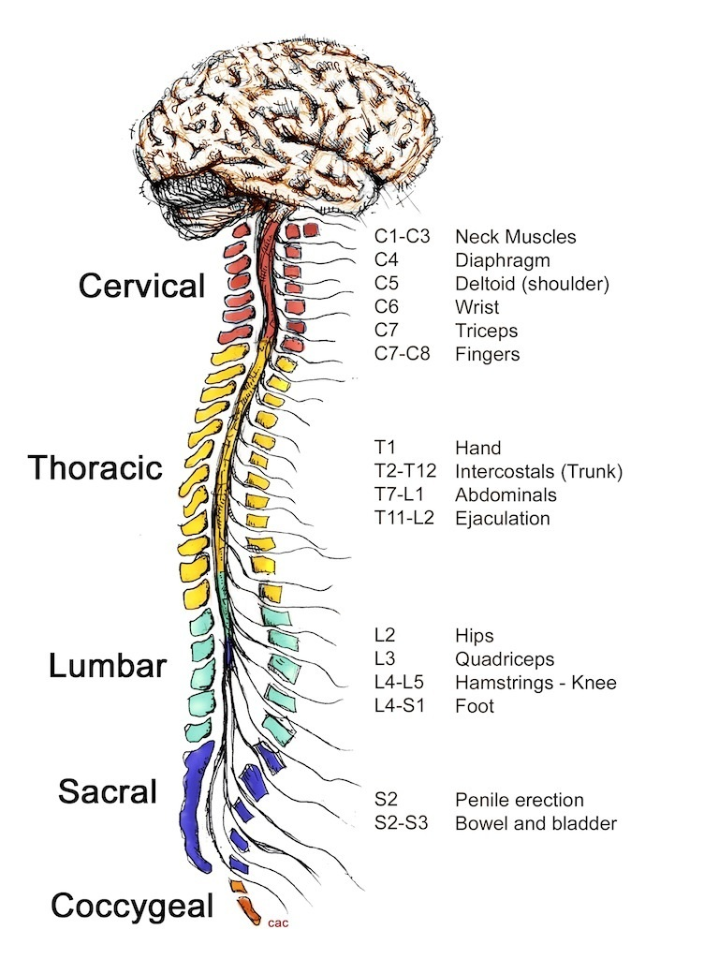
The spinal cord is a long thin bundle of nerves that runs down your back. It connects your brain to the rest of your body like a highway for messages.
Some functions
Carries messages
Controls reflexes
Some interesting facts
It works very fast. Messages travel through the spinal cord at speeds up to 250 miles or 400 kilometers per hour.
Some actions do not go to the brain. Reflexes happen fast because they skip the brain and go straight through the spinal cord.

Slide 8


Thank you
Introducing me
Introducing sir

